Slide 1
CHAPTER FIVE
Mean-Variance Portfolio Theory
Chapter Overview
Introduction
Measuring Risk and Return for a Single Asset
Measuring Portfolio Risk and Return
The Efficient Set with Two Risky Assets
The Efficient Set with One Risky and One Risk-Free Asset
Optimal Portfolio Choice: Many Assets
Portfolio Diversification and Individual Asset Risk

Slide 2
INTRODUCTION
Chapter Objectives
The state preference model is useful as a general approach, it is lacking in empirical content as it would be difficult to list all payoffs offered in different states of nature
This chapter, therefore, works to develop the idea of mean-variance objects of choice—an approach which, due to its statistical nature, is much more open to empirical testing

Slide 3
Measuring Risk and Return
A Single Asset
A crucial piece of information about a security is its expected rate of return—that is, the expected increase in end-of-period wealth which the security should, on average, provide
Mathematically, this can be represented as follows:
R = (W – I) / I; where, R = Rate of Return
W = End-of-Period Wealth
I = Initial Investment
This same expression can be used for the present or future value formulas:
FV: W = (1+R)I PV: I = (1+R)⁻¹W

Slide 4
Measuring Risk and Return
A Single Asset
If end-of-period wealth is known with certainty, then so is the present value of the investment and the rate of return
In real life, this is not often the case; therefore, the best that we can typically do is assign probabilities to various possible outcomes
Assume, for instance, a security with a current price, P₀, of $50 per share

Slide 5
Measuring Risk and Return
A Single Asset
p_{i} = prob. | End of period price | R_{i} = Return (%)
0.15 | $35 | -0.30
0.10 | $42 | -0.16
0.30 | $50 | 0.00
0.20 | $55 | 0.10
0.25 | $60 | 0.20

Slide 6
Measuring Risk and Return
Measures of Location and Dispersion
Since uncertainty is normal, it is desirable to develop some statistics that can summarize a wide set of possible outcomes
The most commonly used statistics are measures of location and dispersion
We shall begin with measures of location which are intended to describe the most likely outcome in a set of events

Slide 7
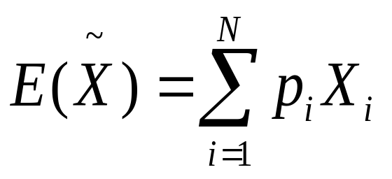
Measuring Risk and Return
Measures of Location
The most often used measure of location is the mean or expectation
It is defined mathematically as follows:

Slide 8
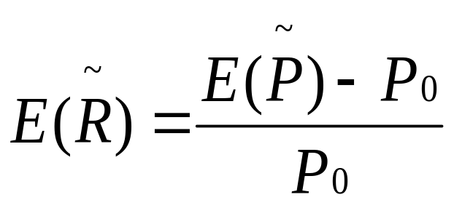
Measuring Risk and Return
Measures of Location
The expected or mean rate of return is the expected price of a security less the current price divided by the current price
It is defined mathematically as follows:

Slide 9
Measuring Risk and Return
Measures of Location
Though the mean is the most commonly used measure of location, the median—a measure defined as the outcome at the 50th percentile of a distribution—is also useful when skewness of a material nature exists
The mode is also useful; however, with security returns, the same real numbers are unlikely to repeat themselves

Slide 10
Measuring Risk and Return
Measures of Dispersion
Measures of location are useful for determining an expected outcome; however, they do not provide any information with regards to risk
Measures of dispersion are, therefore, necessary in order to shed some light on this important component of security returns

Slide 11
Measuring Risk and Return
Measures of Dispersion
The range is the simplest measure of dispersion and is defined as the difference between the highest and lowest outcomes
Though easy to use, the range is of limited utility as it often grows unnecessarily larger with sample size

Slide 12
Measuring Risk and Return
Measures of Dispersion
The semi-interquartile range, on the other hand, is another measure of dispersion which is defined as the difference between the observation of the 75th percentile and the 25th percentile divided by two
Though still imperfect, the semi-interquartile range helps to rectify the major shortcoming of the range to some extent because it eliminates outlying values from consideration

Slide 13
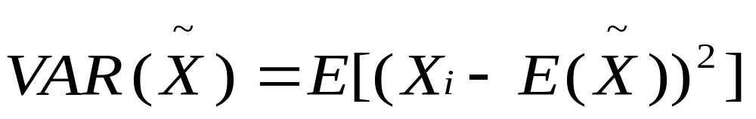
Measuring Risk and Return
Measures of Dispersion
The variance is the statistic most frequently used to measure the dispersion of a distribution
It is defined as the expectation of the squared differences from the mean:

Slide 14
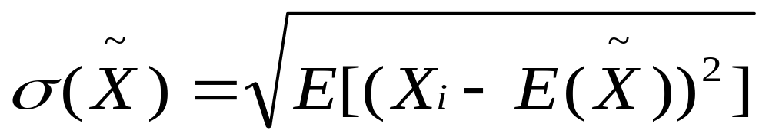
Measuring Risk and Return
Measures of Dispersion
For security prices, the variance—though commonly used—measures dispersion in terms of dollars squared
The standard deviation—defined as the square root of the variance—is often used, therefore, to eliminate this source of confusion:

Slide 15
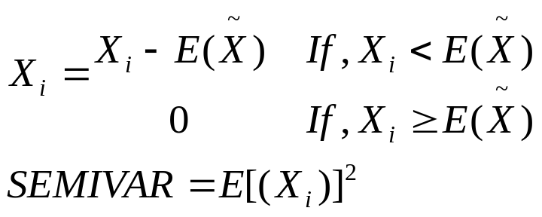
Measuring Risk and Return
Measures of Dispersion
Additionally, the semi-variance is another measure of dispersion which is useful when investors merely wish to focus on the variability of the downside risk of a security (returns below the mean)
In order to determine the semi-variance of a security, all returns greater than the mean are given a value of zero while all returns less than the mean are given the value of their difference vis-à-vis the mean

Slide 16
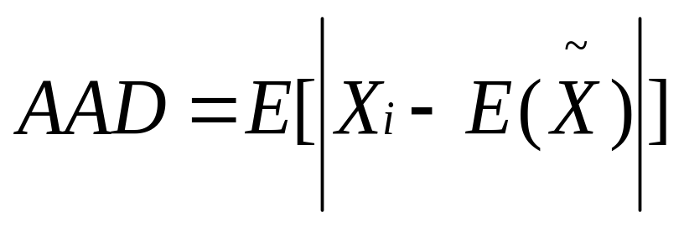
Measuring Risk and Return
Measures of Dispersion
Now, variance, semi-variance, and standard deviation are all sensitive to outlying observations; however, a final statistic is able to avoid this difficulty—average absolute deviation which is defined as the expectation of the absolute value of the differences from the mean

Slide 17
Measuring Risk and Return
Final Thoughts
There are clearly a number of different techniques by which we can measure a security’s location and dispersion
The mean and the variance—flawed as they both are—are the most commonly used both within and without academia
For our purposes, therefore, these two measures shall serve as the basis for the remainder of our discussion

Slide 18
Measuring Portfolio Risk and Return
Risk and Return
From this point, we assume that investors measure the expected utility of choices among risky assets by looking at the mean and variance provided by combinations of those assets
For a financial manager, the operating risk of a firm may be measured by estimating the mean and variance of returns provided by the portfolio of assets that the firm holds
For a portfolio manager, the risk and return are the mean and variance of the weighted average of the assets in his or her portfolio

Slide 19
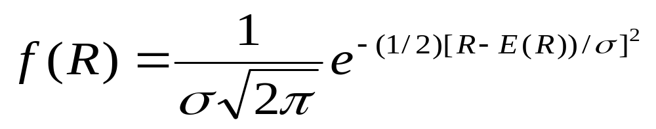
Measuring Portfolio Risk and Return
Assume Normality
Unless investors have a special type of utility function (such as, for instance, a quadratic utility function), it is necessary to assume that returns have a normal distribution which can be completely described by mean and variance
Mathematically, this is defined as follows:

Slide 20
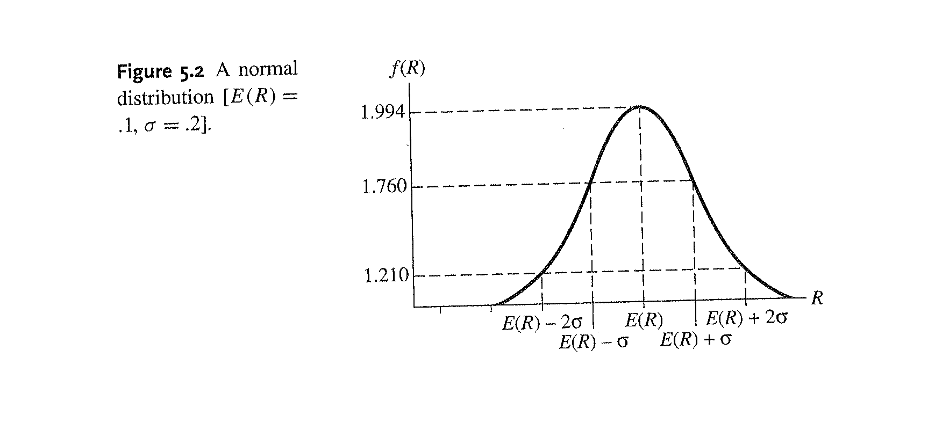
Measuring Portfolio Risk and Return
Assume Normality

Slide 21
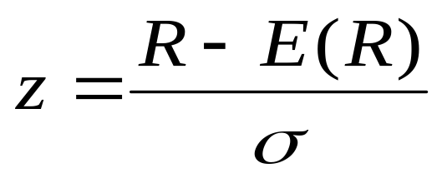
Measuring Portfolio Risk and Return
Assume Normality
Often a normal distribution is converted into a unit normal distribution that always has a mean of zero and a standard deviation of one
To convert a return, R, into a unit normal variable, z, subtract the mean, E(R), and divide by the standard deviation:

Slide 22
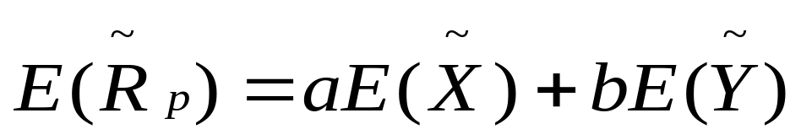
Measuring Portfolio Risk and Return
Mean and Variance in a Two-Asset Portfolio
Assuming normality, a two-asset portfolio return can be expressed as the weighted sum of the returns of the individual securities:

Slide 23
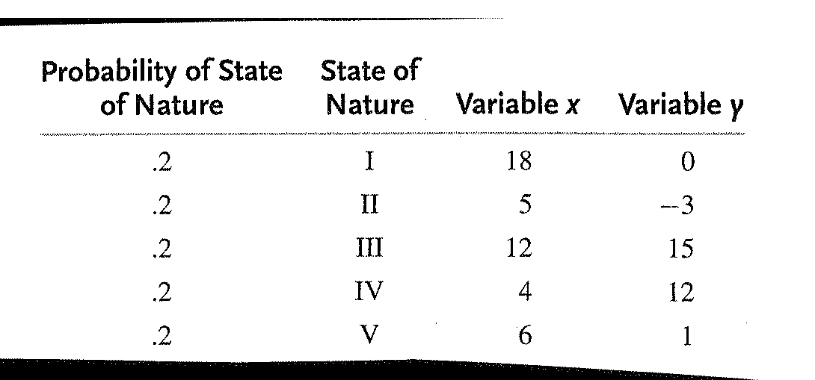
Measuring Portfolio Risk and Return
Mean and Variance in a Two-Asset Portfolio

Slide 24
Measuring Portfolio Risk and Return
Mean and Variance in a Two-Asset Portfolio
Assuming normality, the variance of a two-asset portfolio can be expressed as follows:
The final term in this equation is the covariance of the portfolio

Slide 25
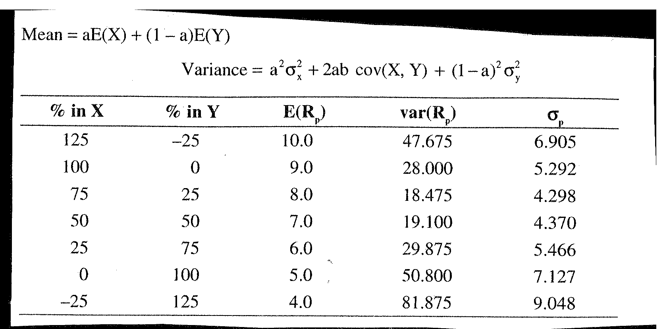
Measuring Portfolio Risk and Return
Mean and Variance in a Two-Asset Portfolio

Slide 26
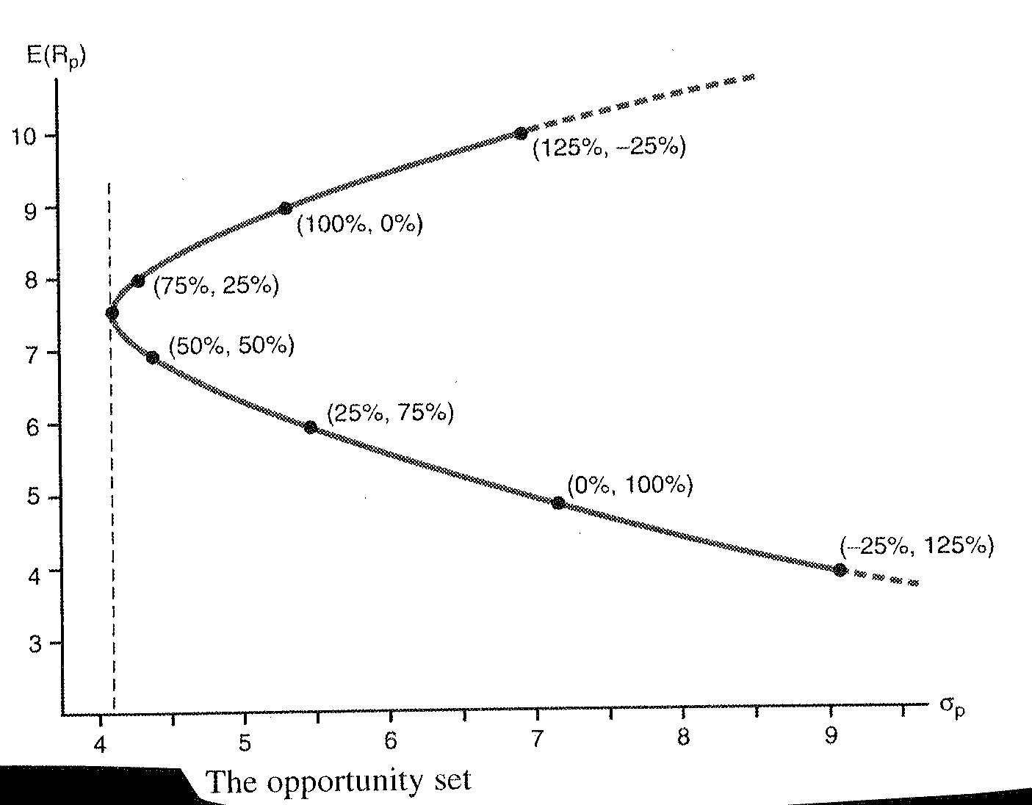
Measuring Portfolio Risk and Return
The Trade-off Between
Mean and Standard Deviation

Slide 27
Measuring Portfolio Risk and Return
Understanding Covariance
The covariance between two securities is very important for portfolio formation
Negative covariance implies that the returns on two assets tend to move in opposite directions
Positive covariance implies that the returns on two assets tend to move in the same direction

Slide 28
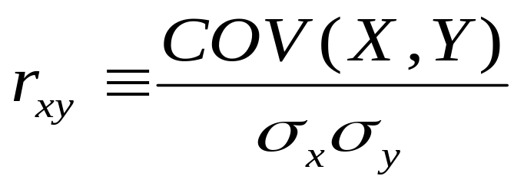
Measuring Portfolio Risk and Return
Correlation
A related concept is that of correlation which is defined as the covariance divided by the product of the standard deviations of the two securities of interest
It is defined mathematically as follows:

Slide 29
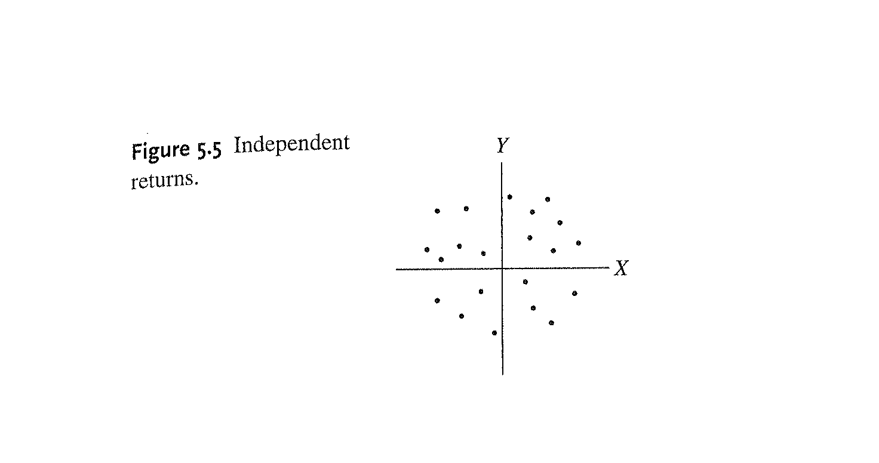
Measuring Portfolio Risk and Return
Understanding Correlation

Slide 30
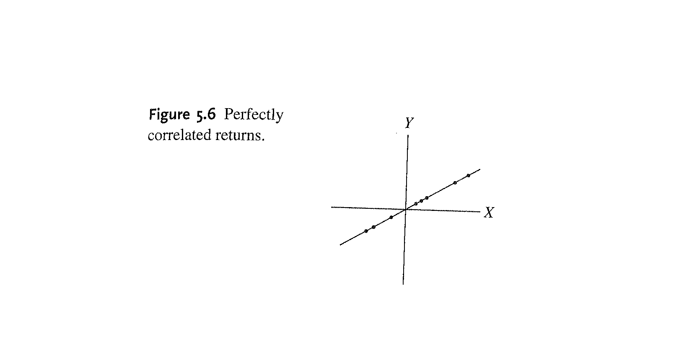
Measuring Portfolio Risk and Return
Understanding Correlation

Slide 31
Measuring Portfolio Risk and Return
Substituting Correlation Into the Variance Equation
The relationship between covariance and correlation allows for the alteration of the portfolio variance equation:
This reformulation can be used to find the combination of random variables, X and Y, that provides the portfolio with minimum variance

Slide 32
Measuring Portfolio Risk and Return
Minimum Variance Opportunity Set
The minimum variance opportunity set is the locus of risk and return combinations offered by portfolios of risky assets that yields the minimum variance for a given rate of return
The convex portion of the figure on the next slide is representative of the minimum variance opportunity set
The vertical dashed line is the minimum variance portfolio

Slide 33
Measuring Portfolio Risk and Return
Risk and Return Trade-offs for Two Assets

Slide 34
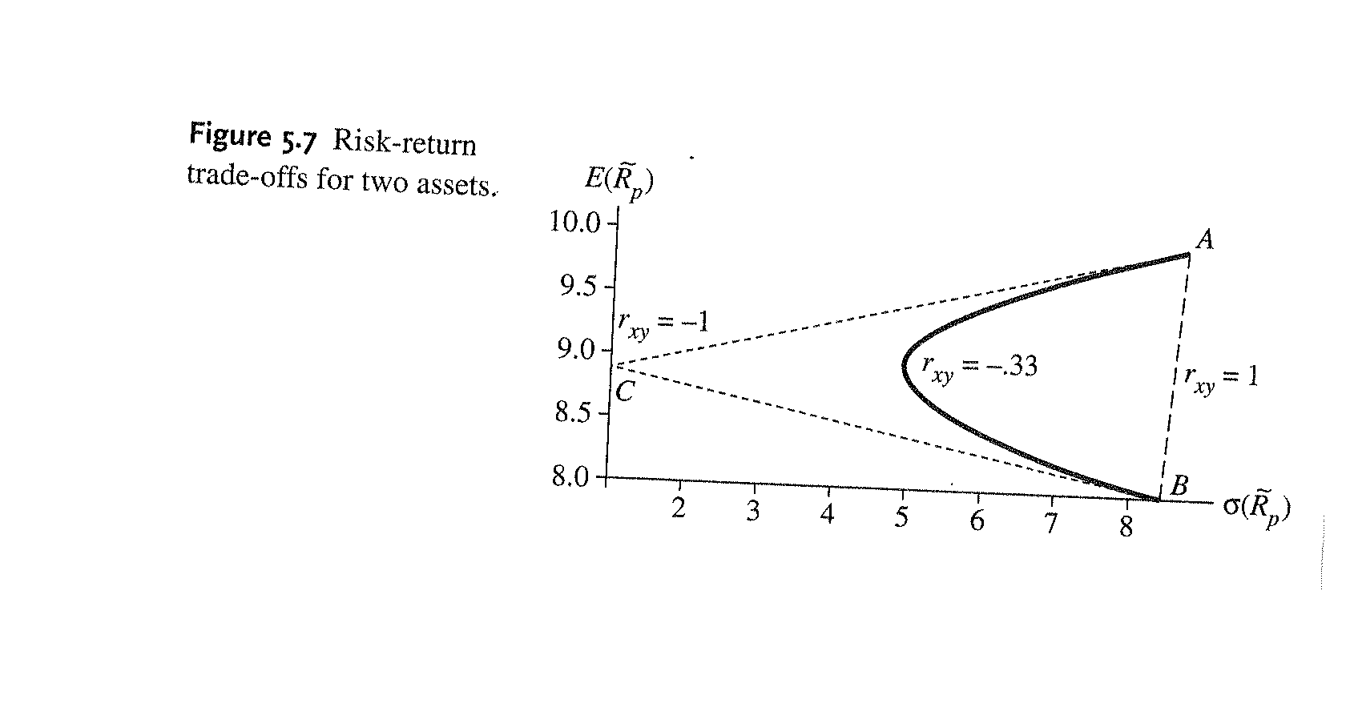
Measuring Portfolio Risk and Return
Perfectly Correlated Assets

Slide 35
The Efficient Set with Two Risky Alternatives
Maximizing Expected Utility
It is natural to now progress with this discussion by examining how a single individual will choose his opportunity optimal portfolio of risky assets in a world where there is no opportunity for exchange
This section is analogous to the Robinson Crusoe economy described in the first chapter; however, the objects of choice are risk and return rather than consumption and investment

Slide 36
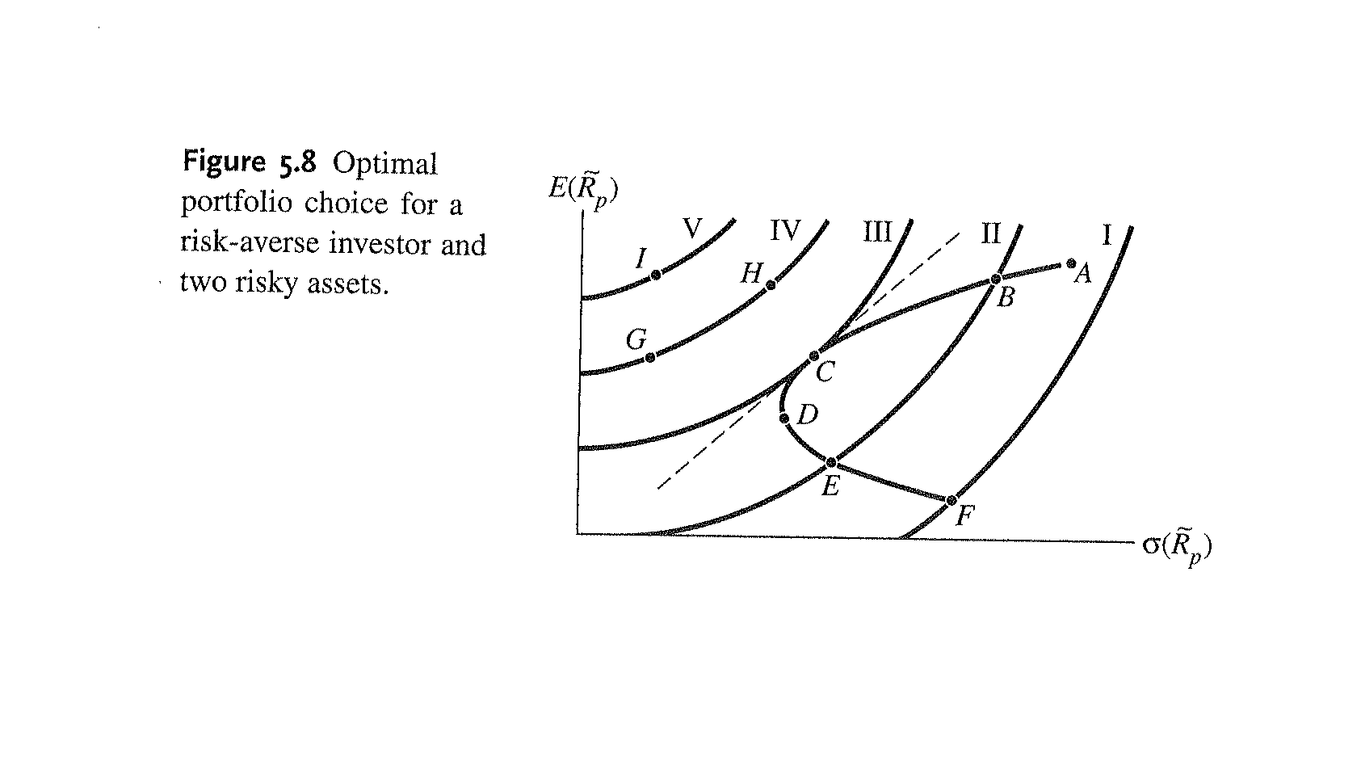
The Efficient Set with Two Risky Alternatives
Maximizing Expected Utility

Slide 37
The Efficient Set with Two Risky Alternatives
Maximizing Expected Utility
An important feature of the optimal portfolio that we choose in order to maximize our utility is that the marginal rate of substitution between our preference for risk and return represented by our indifference curves must equal the marginal rate of transformation offered by the minimum variance opportunity set

Slide 38
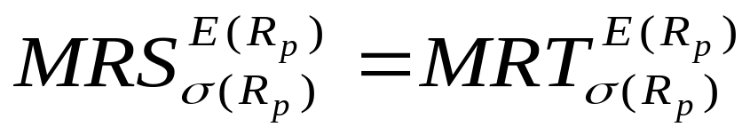
The Efficient Set with Two Risky Alternatives
Maximizing Expected Utility
We can find a utility-maximizing portfolio by finding one along the opportunity set where the marginal rate of transformation between risk and return along the minimum variance opportunity set just equals the marginal rate of substitution along our indifference curve:

Slide 39
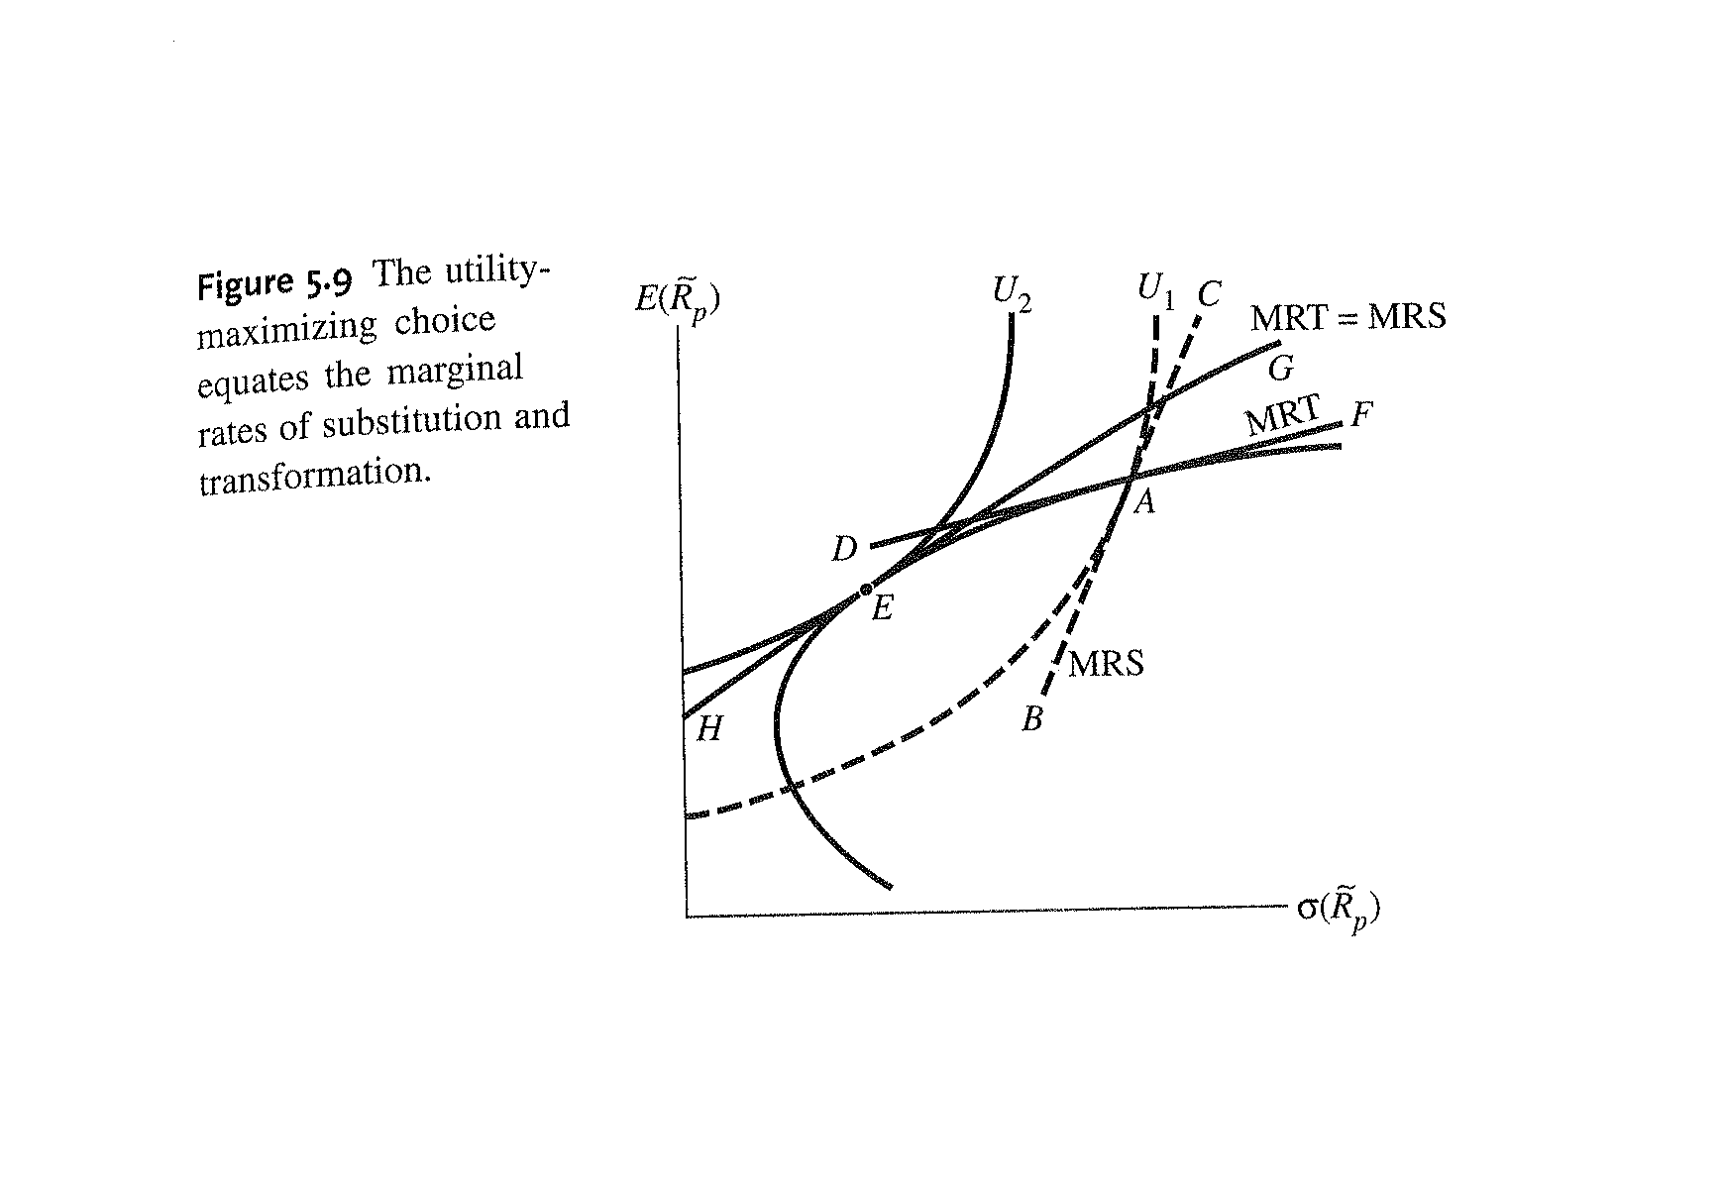
The Efficient Set with Two Risky Alternatives
Maximizing Expected Utility

Slide 40
The Efficient Set with Two Risky Alternatives
Maximizing Expected Utility
Investors may have the same assessment of the return and risk offered by risky assets; however, they may hold different portfolios due to differences in individual utility

Slide 41
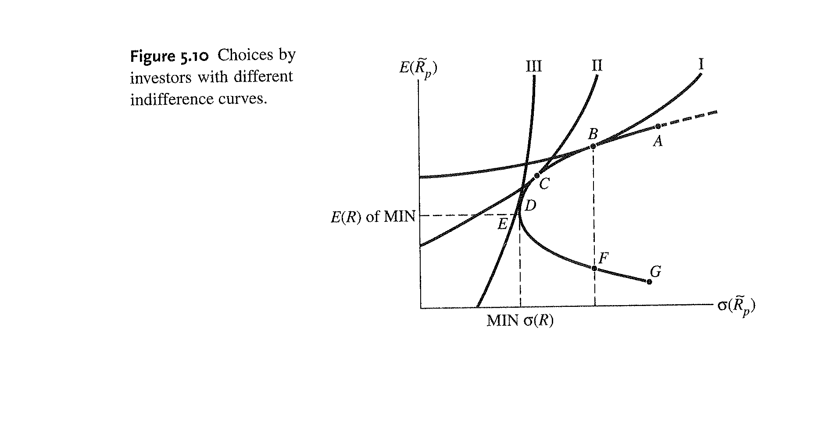
The Efficient Set with Two Risky Alternatives
Maximizing Expected Utility

Slide 42
The Efficient Set with Two Risky Alternatives
The Efficient Set
Investors will not select portfolios below the minimum variance point
This leads to the definition of the efficient set—the set of mean-variance choices from the investment opportunity set where for a given variance (or standard deviation) no other investment opportunity offers a higher mean return

Slide 43
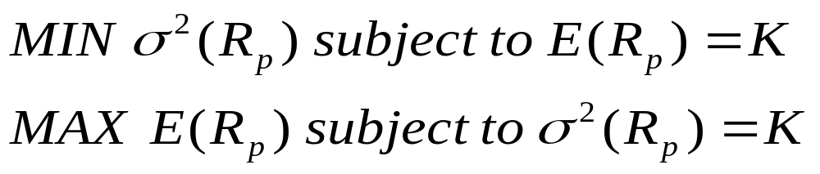
The Efficient Set with Two Risky Alternatives
Selecting an Efficient Portfolio
The locus of feasible mean-variance opportunities can be found by solving either of the following two mathematical programming problems:

Slide 44
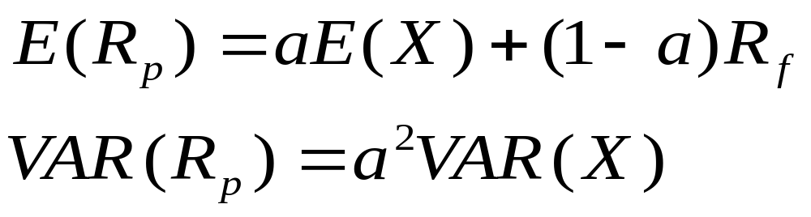
The Efficient Set with a Risky and a Risk-Free Asset
Introducing Risk-Free Assets
If one of the two assets, R_{f} , has zero variance, then the mean and variance of the portfolio become:

Slide 45
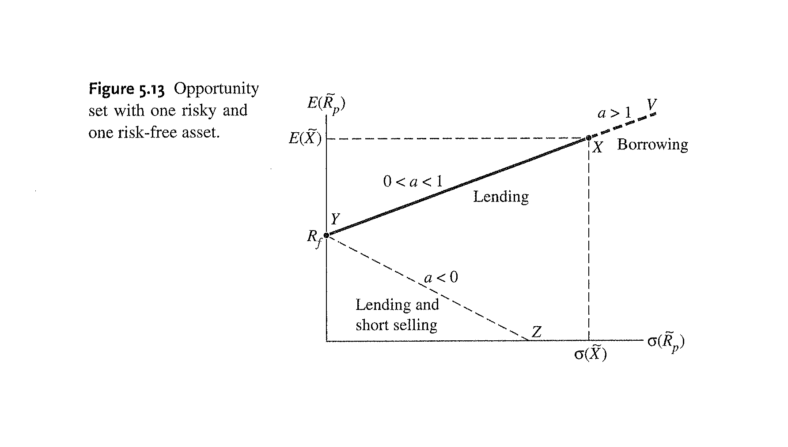
The Efficient Set with a Risky and a Risk-Free Asset
Introducing Risk-Free Assets

Slide 46
The Efficient Set with a Risky and a Risk-Free Asset
Introducing Risk-Free Assets
It is usually assumed that the rate of return on the risk-free asset is equal to the borrowing and lending rate in the economy
This assumption does not match reality because of frictions in the marketplace; however, it is very convenient for the purposes of theory building

Slide 47
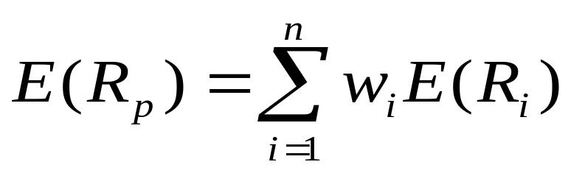
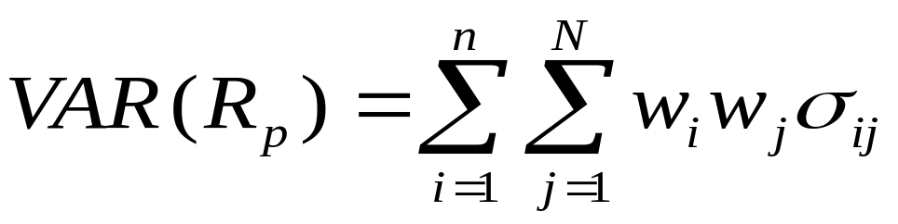
Optimal Portfolio Choice: Many Assets
Portfolio Mean, Variance, and Covariance
For portfolios with more than two assets, the definition of the portfolio mean return is:
For portfolios with more than two assets, the definition of the portfolio variance is:

Slide 48
Optimal Portfolio Choice: Many Assets
The Opportunity Set with N Risky Assets
The investment opportunity set has the same slope with many risky assets as it does with two
Similarly, a risk-averse investor would maximize his or her expected utility in the same way as before—by finding the point of tangency between the efficient set and the highest indifference curve
All of the means, variances, and covariances would have to be estimated

Slide 49
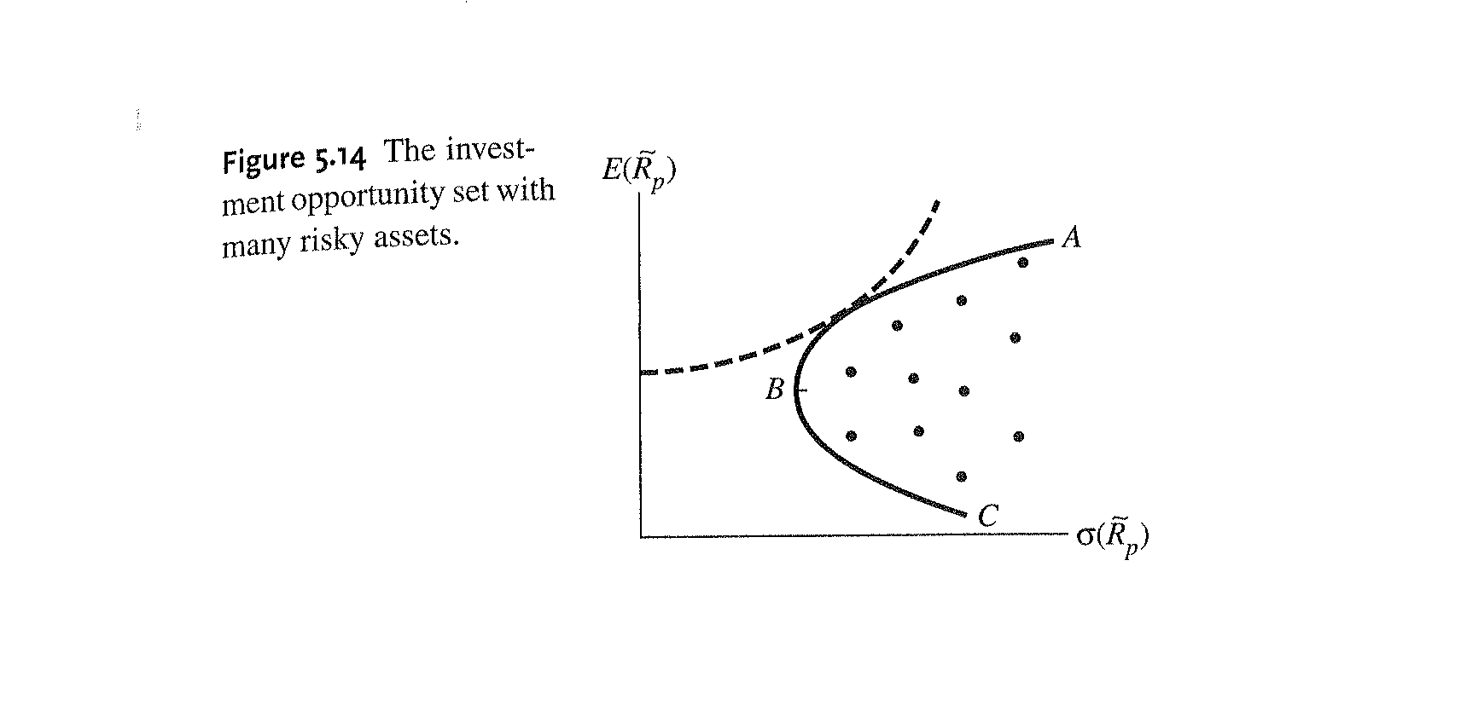
Optimal Portfolio Choice: Many Assets
The Opportunity Set with N Risky Assets

Slide 50
Optimal Portfolio Choice: Many Assets
The Efficient Set with N Risky Assets and One Risk-Free Asset
When the risk-free asset is introduced into the analysis, the problem of portfolio selection is simplified
Assuming that the borrowing rate equals the lending rate, we can draw a straight-line between any risky asset and the risk-free asset

Slide 51
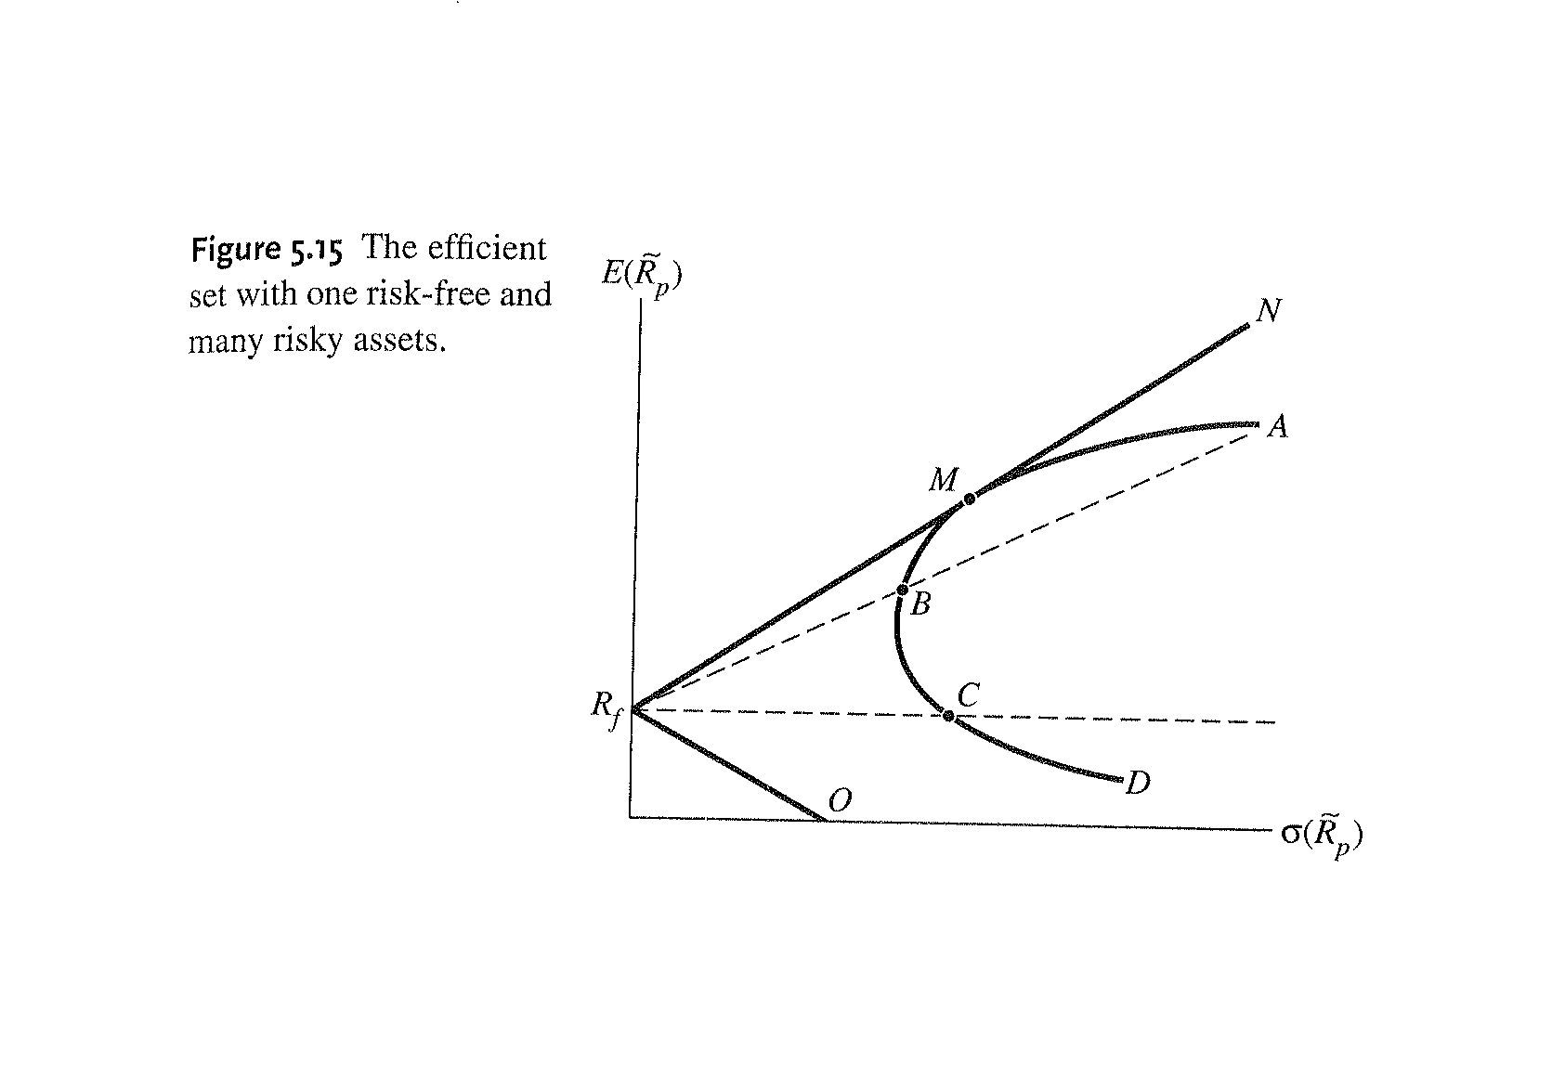
Optimal Portfolio Choice: Many Assets
The Efficient Set with N Risky Assets and One Risk-Free Asset

Slide 52
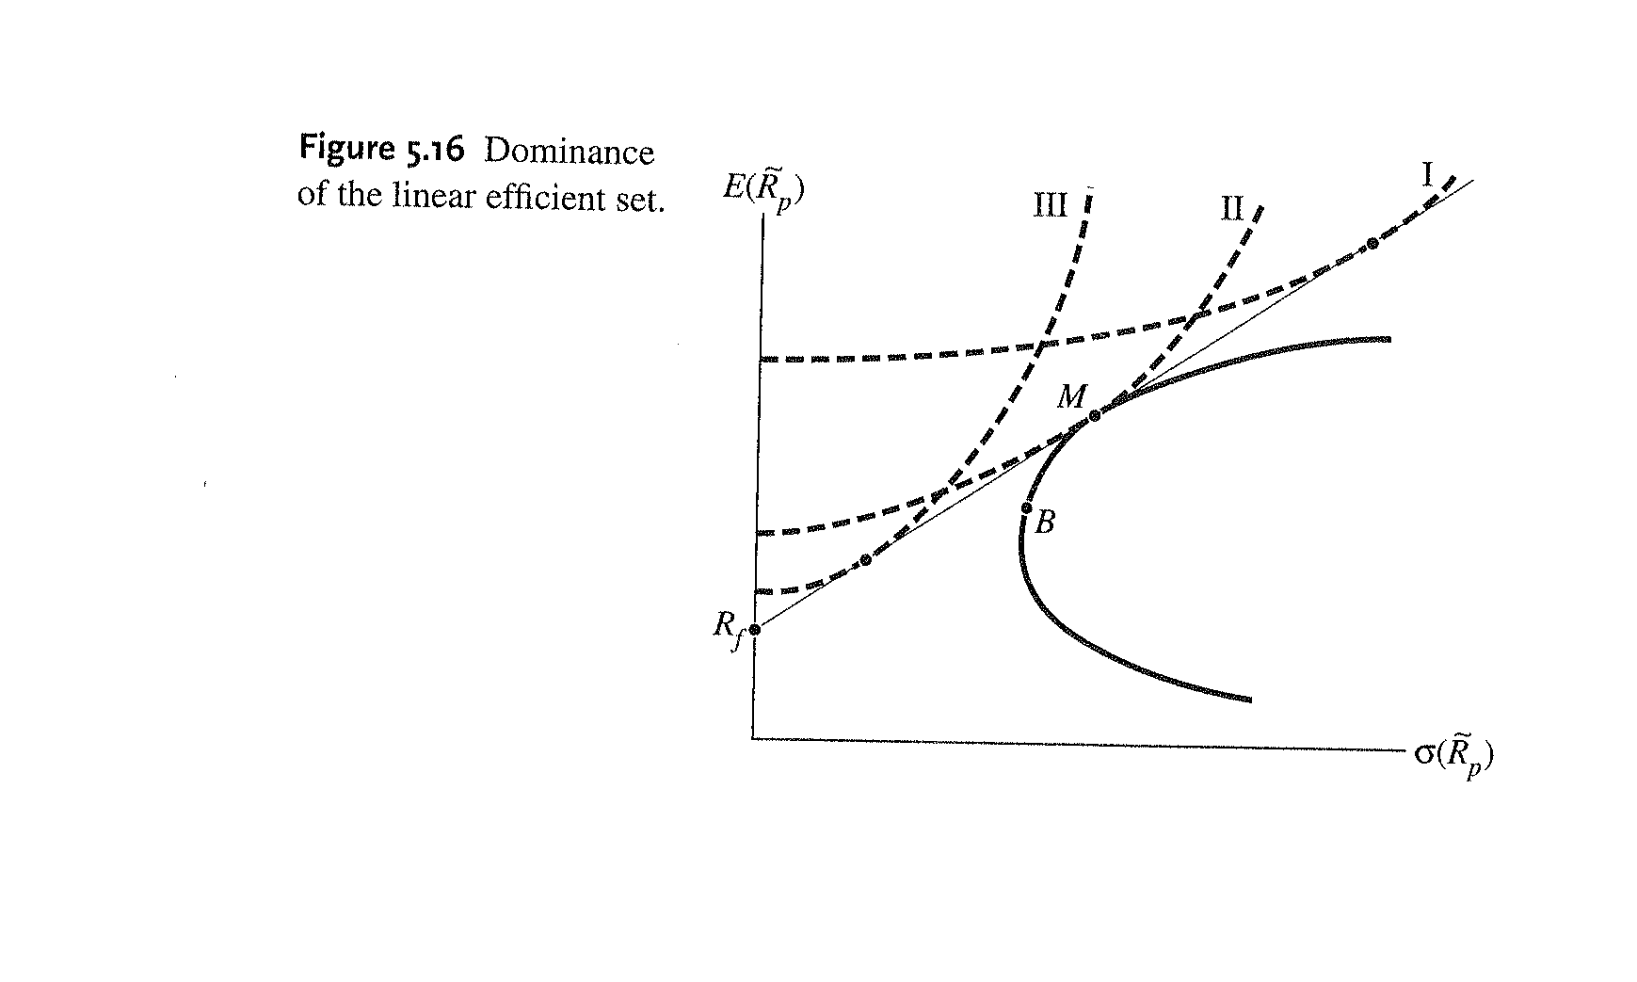
Optimal Portfolio Choice: Many Assets
The Efficient Set with N Risky Assets and One Risk-Free Asset

Slide 53
Optimal Portfolio Choice: Many Assets
A Description of Equilibrium
Up until now, we have assumed that there is no market available in our model economy
An individual’s optimal portfolio resulted from maximizing his expected utility, given his risk preferences, subject to the feasible set of mean-variance trade-offs offered by a combination of assets
The introduction of a risk-free asset may be thought of as creating an exchange or market economy where there are many individuals

Slide 54
Optimal Portfolio Choice: Many Assets
A Description of Equilibrium
If we add the simplifying assumption that all investors have homogenous beliefs about the expected distributions of returns offered by all assets, then all investors will perceive the same efficient set
All investors will, therefore, try to hold some combination of the risk-free asset, R_{f} , and portfolio M

Slide 55
Optimal Portfolio Choice: Many Assets
A Description of Equilibrium
For the market to be in equilibrium, we require a set of market-clearing prices
In other words, the excess demand for any asset must be zero

Slide 56
Optimal Portfolio Choice: Many Assets
A Description of Equilibrium
The market-clearing condition implies that an equilibrium is not attained until the single-tangency portfolio, M, which all investors (with homogenous expectations) try to combine with risk-free borrowing or lending, is a portfolio in which all assets are held according to their market value weights

Slide 57
Optimal Portfolio Choice: Many Assets
A Description of Equilibrium
Market equilibrium is not reached until the tangency portfolio, M, is the market portfolio
The fact that the portfolios of all risk-averse investors will consist of different combinations of only two portfolios is an extremely powerful result

Slide 58
Optimal Portfolio Choice: Many Assets
Two-Fund Separation
This result yields the two-fund separation principle:
Each investor will have a utility-maximizing portfolio that is a combination of the risk-free asset and a portfolio (or fund) of risky assets that is determined by the line drawn from the risk-free rate of return tangent to the investor’s efficient set of risky assets

Slide 59
Optimal Portfolio Choice: Many Assets
Two-Fund Separation

Slide 60
Optimal Portfolio Choice: Many Assets
Capital Market Line
The straight line in Figure 5.16 is representative of the efficient set for all investors
This line is referred to as the Capital Market Line or CML

Slide 61
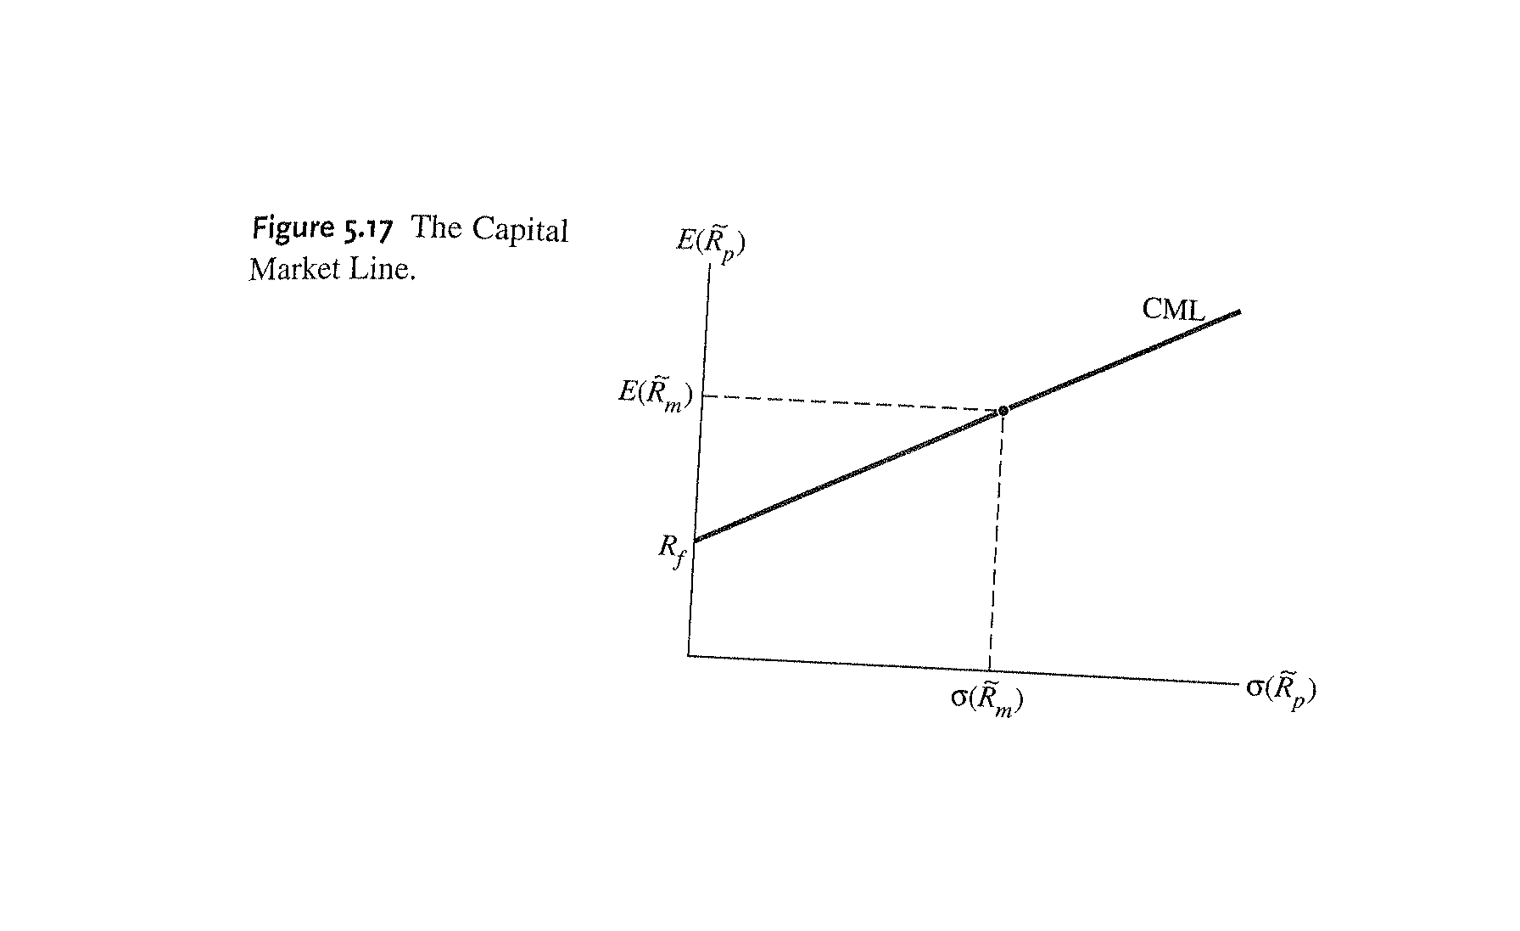
Optimal Portfolio Choice: Many Assets
Capital Market Line

Slide 62
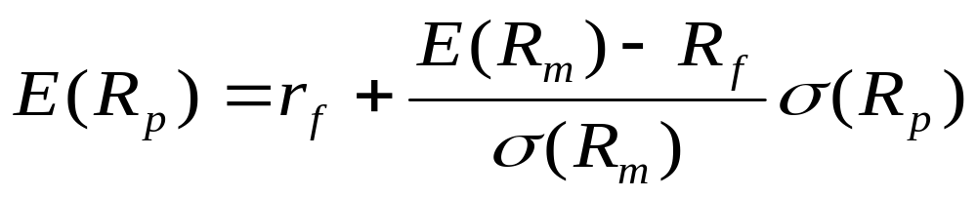
Optimal Portfolio Choice: Many Assets
Capital Market Line
The equation of the CML is:

Slide 63
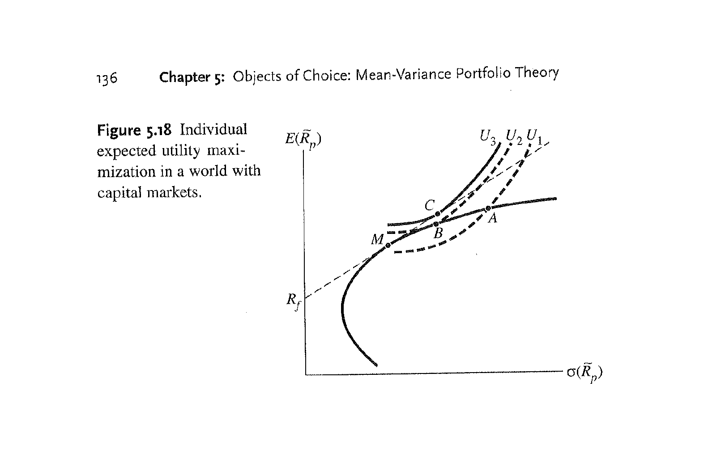
Optimal Portfolio Choice: Many Assets
Individual Utility Maximization

Slide 64
Optimal Portfolio Choice: Many Assets
Individual Utility Maximization
Nearly everyone is better off in a world with capital markets (and no one is worse off)
Two fund separation holds
And, in equilibrium, the MRS between risk and return is the same for all individuals, regardless of their subjective attitudes towards risk

Slide 65
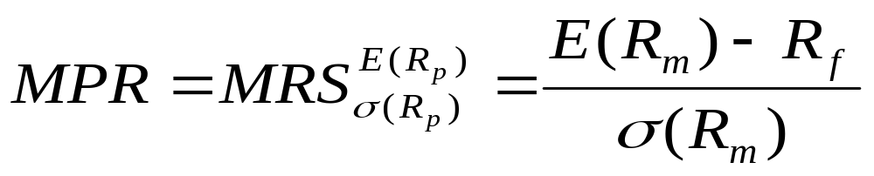
Optimal Portfolio Choice: Many Assets
Evaluating Investment Projects
If the marginal rate of substitution between risk and return is the same for every individual in equilibrium, then the slope of the CML is the market price of risk (MPR):

Slide 66
Optimal Portfolio Choice: Many Assets
Evaluating Investment Projects
The implication of this is that decision makers (e.g., managers of firms) can use the market-determined equilibrium price of risk to evaluate investment projects regardless of the tastes of shareholders because all will unanimously agree on the price of risk

Slide 67
Portfolio Diversification
Variance and the Number of Assets
Before moving onto the next chapter, it is important to address one last thing: the matter of distinguishing between portfolio risk and the contribution of a single asset to the riskiness of a well-diversified portfolio

Slide 68
Portfolio Diversification
Variance and the Number of Assets
As the number of assets in a portfolio increases the portfolio variance decreases and approaches the average covariance
Consequently, as we form portfolios that have large numbers of assets that are better diversified, the covariance terms become relatively more important and represent the risk contributions of individual assets

Slide 69
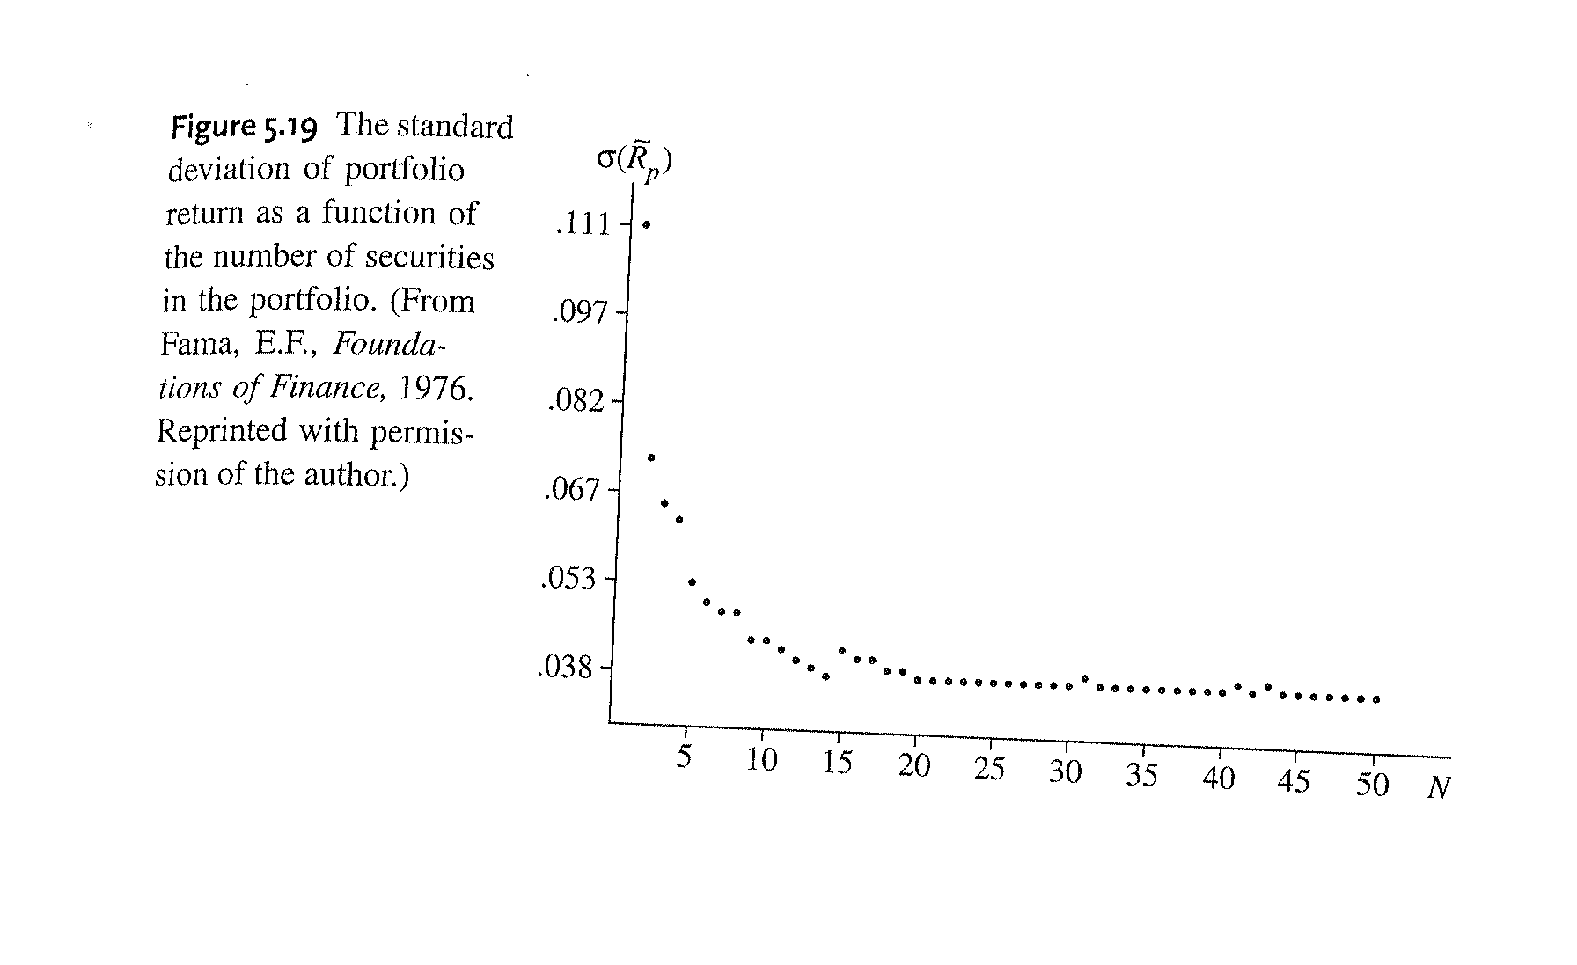
Portfolio Diversification
Variance and the Number of Assets

Slide 70
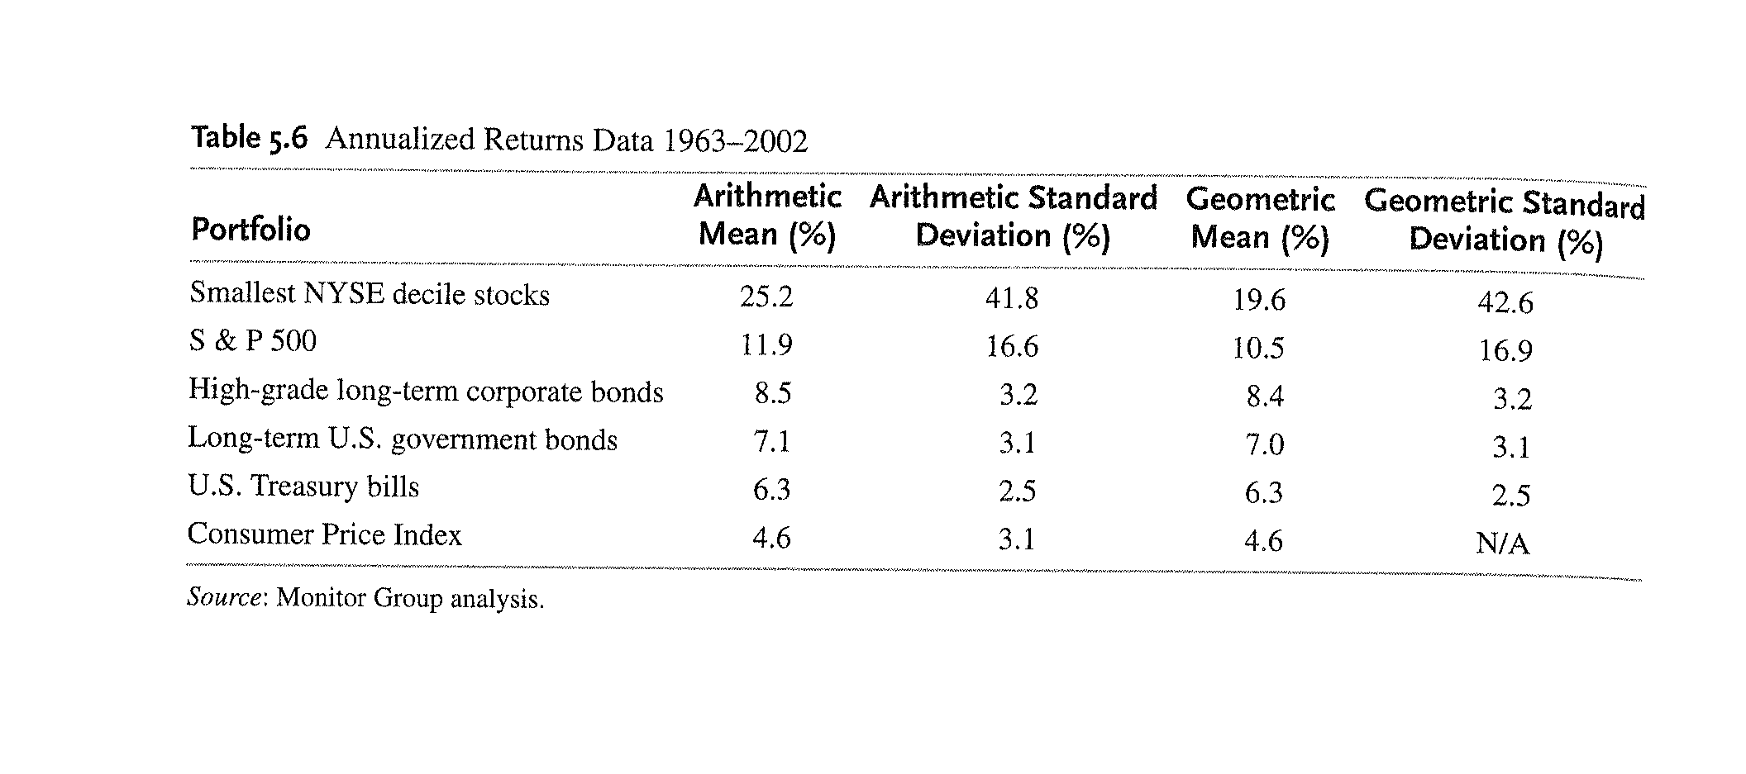
Portfolio Returns and Limits to Diversification

Slide 71
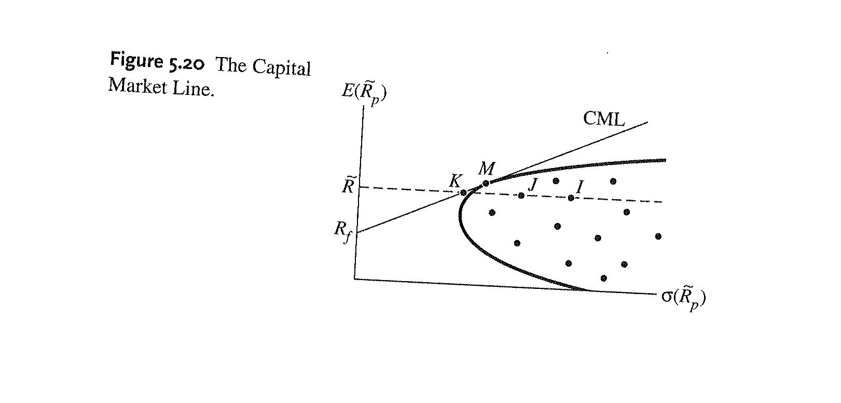
Which Measure of Risk is Important?

